Slide 1


Introduction to Git and GitHub
Noel Mc Grath

Slide 2
Agenda
Getting to know Git
Working with Git locally
Working with Git remotely
Branching and Merging
Git integration
GitHub
GitHub for Windows

Slide 3
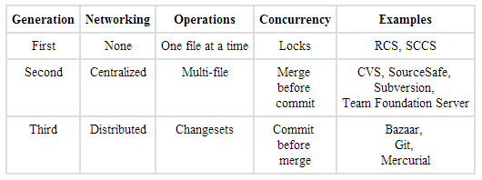
History of Version Control Systems
http://www.ericsink.com/vcbe/html/history_of_version_control.html

Slide 4
Why Use Version Control?
Lecturers
Students
Used in the industry
Software evolution
Track individual and group projects
Preparing for work
Sharing and collaboration
Workflow
Rollbacks

Slide 5
Distributed Version Control Systems (DVCS for short)
Full history on local repository
You commit changes to your own repository
The owner of the official repository can pull those changes
Can have a centralised repository that all contributors can push to
Branching/merging reliable and easy
Backups are easy – each clone is a full backup
Deployments - heroku
Notes:
Draw difference between central and distributed

Slide 6
Git
Created by Linus Torvalds for Linux kernel development in 2005
Linux fell out with BitKeeper
Free and open source
Runs on many OS’s
Handle small to very large projects
Fast performance
Cheap local branching
Simplicity

Slide 7
Installation On Windows
http://msysgit.github.io/
Configure Git
Levels
System
User
Repository

Slide 8
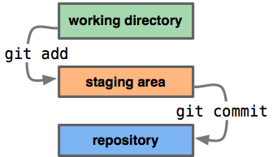
Our First Repository
Creating a repository
Adding files and committing
Making changes and diffs
Viewing history
Refactoring and viewing diffs
Ignoring files using .gitignore
Demo

Slide 9
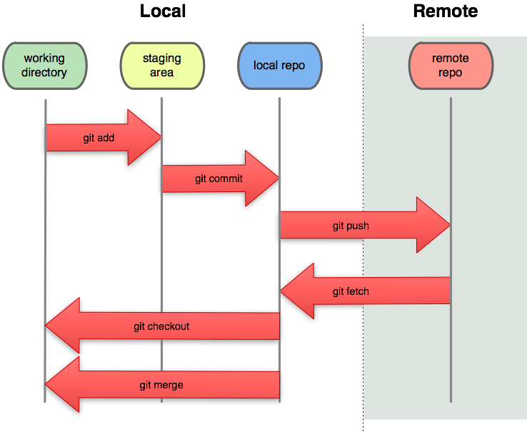
Working With Remote Repository
Cloning
Listing repositories
Fetching and Merging
Pulling
Pushing changes
Tags
Demo

Slide 10
Command Line or GUI?
GUI and IDE options
Git Gui
TortoiseGit
Git Extensions
SourceTree
Visual Studio Tools for Git
GitHub on Windows
Egit – Eclipse
Many more …..

Slide 11
GitHub
TODO

Slide 12
Git and TFS
TODO

Slide 13
Branching and Merging
TODO

Slide 14
Git internals
TODO

Slide 15
Resources
Pro Git
http://git-scm.com/book
GIT IMMERSION
http://gitimmersion.com/lab_01.html
git ready
http://gitready.com
Linus Torvalds on git
https://www.youtube.com/watch?v=4XpnKHJAok8
Search

